Slide 1

GitHub Copilot Hackathon
Team Name- SatyamPandey
Team Leader Name- Satyam Pandey
Team Leader Email Address- stmpnd63@gmail.com

Slide 2
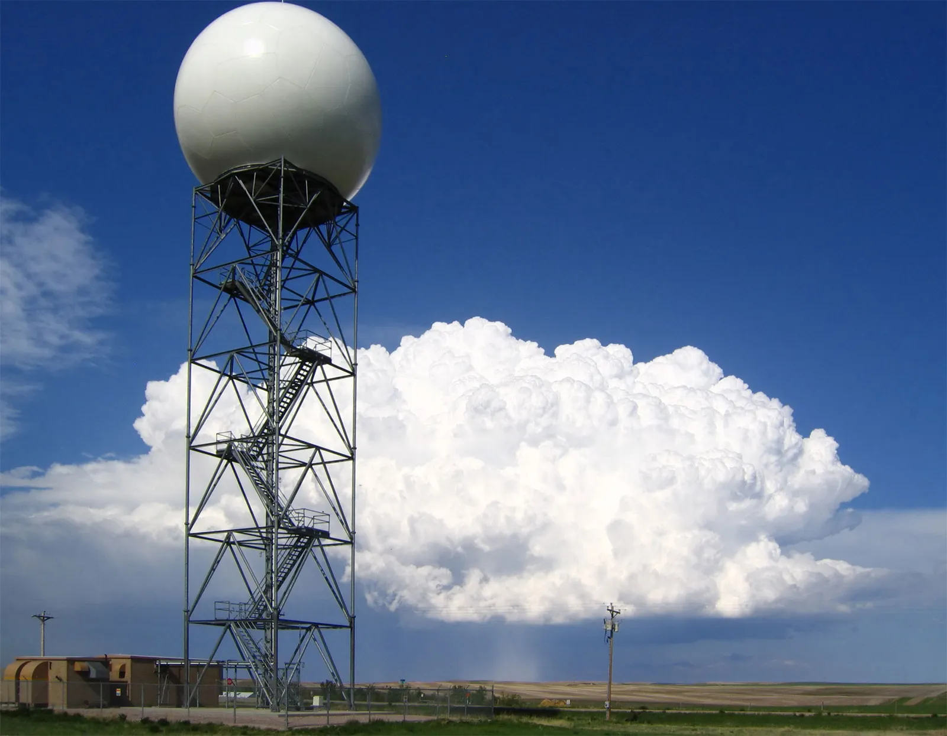
Weather Forecasting Tool

Slide 3

Outline : Brief Summary of Project
Introduction
The Science of Weather Forecasting
Python for Weather Forecasting
Building a Weather Forecasting Tool with Python
Case Study: Using Python for Severe Weather Prediction
OpenWeatherMap API
Python and GitHub Copilot
Demo
Creating the command line tool
High Level Architecture
Business Challenge
Conclusion
References and Links
Code and Output

Slide 4

Introduction:
Weather forecasting is an essential part of our daily lives. It helps us plan our day, prepare for severe weather events, and make informed decisions about our safety. Inaccurate weather predictions can have serious consequences, which is why it's crucial to have reliable tools and methods for forecasting. In this presentation, we will explore the topic of weather forecasting and the importance of accurate predictions.

Slide 5

Introduction (Continued):
We will also discuss how Python can be used as a powerful tool for weather forecasting. Python is a popular programming language that can be used for data analysis, visualization, and prediction. Its flexibility and ease of use make it an ideal choice for weather forecasting applications.
We have used “openweathermap” API to get the accurate weather information using our Python code. We will be entering country, state and city name and code will return the weather information.

Slide 6

The Science of Weather Forecasting:
Weather forecasting is based on the principles of atmospheric science, which involves studying the behavior of the Earth's atmosphere. Meteorologists use a variety of tools and techniques to collect data about temperature, pressure, humidity, wind speed, and other factors that affect weather patterns.
They then use this data to create computer models that simulate weather conditions and predict future patterns. These models are constantly updated with new data to improve their accuracy over time.

Slide 7

Python for Weather Forecasting:
Python has become a popular tool for weather forecasting due to its flexibility and ease of use. It can be used for data analysis, visualization, and prediction, making it an ideal choice for weather forecasting applications.
Python libraries such as NumPy, Pandas, and Matplotlib provide powerful tools for data manipulation and visualization, while machine learning algorithms can be used for predictive modeling. These tools can help meteorologists analyze large amounts of data and make accurate predictions about future weather patterns.

Slide 8
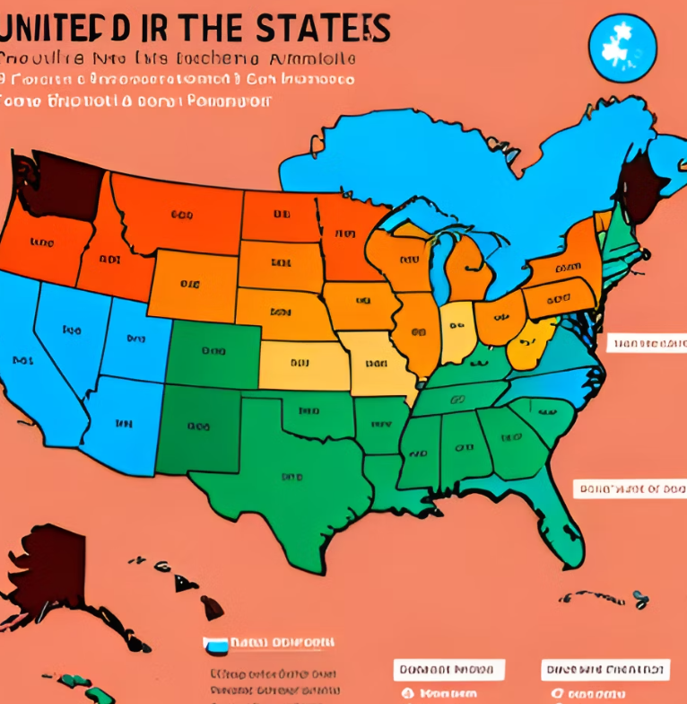
Case Study: Using Python for Severe Weather Prediction
In 2019, a team of meteorologists used Python to predict severe weather events in the United States. They collected data from multiple sources including satellite imagery, radar data, and weather station reports.
Using machine learning algorithms, they built a predictive model that could identify areas at high risk for severe weather events such as tornadoes and thunderstorms. The model was highly accurate, with a success rate of over 90%, and helped to improve public safety by providing early warnings of potential weather hazards.

Slide 9

OpenWeatherMap API:
OpenWeatherMap API is a powerful tool that allows developers to fetch weather data from around the world. With this API, you can access a wide range of weather information, including temperature, humidity, wind speed, and more.
One of the key benefits of using OpenWeatherMap API is its ease of use. The API provides a simple and intuitive interface that makes it easy to fetch weather data for any location in the world.

Slide 10

Python and GitHub Copilot:
Python is a popular programming language that is well-suited for data parsing and manipulation. With its rich set of libraries and tools, Python makes it easy to work with APIs like OpenWeatherMap and parse the resulting data.
GitHub Copilot is an AI-powered coding assistant that can help you write code more efficiently. With its ability to suggest code snippets and complete lines of code, Copilot can be a valuable tool when working with APIs and parsing data in Python.

Slide 11

How we used GitHub Copilot:
In the development process, we utilized GitHub Copilot, an AI-powered code completion tool that helps developers write better code faster. With Copilot, we quickly generated high-quality code snippets based on context and natural language input.
This tool not only helped us streamline our development process but also enabled us to develop more innovative and complex features in less time. By leveraging the power of AI, we focused on delivering value to our customers rather than spending time on mundane coding tasks.

Slide 12

Demo:
To demonstrate how the command-line tool works, let's say we want to fetch the current weather data for New York City. We would simply enter the following command into our terminal: 'python weather.py -c New York'. The script would then make an API call to OpenWeatherMap and return the current weather data for New York City.
We have particularly asked the user the enter the country, state and then city to provide the accurate information. After getting these details, we are giving Temperature, Humidity and Weather conditions.

Slide 13

Creating the Command-line Tool:
To create the command-line tool that fetches weather data using OpenWeatherMap API and parses it using Python and GitHub Copilot, we need to follow a few simple steps. First, we need to register for an API key from OpenWeatherMap. Once we have our API key, we can use it to fetch weather data for any location in the world.
Next, we will need to write a Python script that uses the requests library to make API calls to OpenWeatherMap and parse the resulting data. We can use GitHub Copilot to help you write this code more efficiently and handle errors that may arise during the process.

Slide 14

High Level Architecture:
The high-level architecture for our proposed solution involves integrating Microsoft Cloud Technologies and Github Copilot to create a cohesive platform for software development. At the center of this platform is Azure DevOps, which provides project management and collaboration tools for all stakeholders involved in a project.
Github Copilot is integrated into this platform to provide AI-powered code completion and automate repetitive tasks. This integration allows developers to focus on more complex tasks and improve the quality of their work. Additionally, Azure Functions can be used to automate tasks such as testing and deployment, further streamlining the development process.

Slide 15

Business Challenge: Use case
In today's rapidly changing business landscape, companies face a multitude of challenges. One of the most pressing challenges is the need to stay ahead of the competition by continuously improving their products and services. This requires companies to be agile and responsive to market demands, which can be difficult to achieve in traditional business models.
To address this challenge, companies need to adopt new technologies and processes that enable them to innovate quickly and efficiently. This includes leveraging data analytics, cloud computing, and other cutting-edge technologies to gain insights into customer needs and preferences.

Slide 16

Conclusion:
In conclusion, weather forecasting is an essential part of our daily lives, and accurate predictions are crucial for public safety and decision-making. Python has become a popular tool for weather forecasting due to its flexibility and ease of use.
By using Python libraries and machine learning algorithms, meteorologists can analyze large amounts of data and make accurate predictions about future weather patterns. We encourage everyone to explore the potential of Python for weather prediction and help contribute to the development of more reliable and accurate weather forecasting tools.

Slide 17
Reference and Links:
Github: https://github.com/sp2943/General/tree/Weather-Forecasting-Tool
Open Weather API: https://home.openweathermap.org/api_keys
GitHub Co-Pilot: https://github.com/features/copilot
Collab: https://colab.research.google.com/drive/1IQ24QgGum-vi9fRXDFUWBZU-OUIGn3pS?usp=sharing
PPT Link: https://docs.google.com/presentation/d/1E5-AOjD67SQZwLC1FM00wN5-WbmG1drREEST0sSmnmQ/edit?usp=sharing

Slide 18
Technology/Tool Stack Used:
Python
Open Weather API
GitHub Copilot has been used to generate some code
Collab
PySimpleGUI
Json
Geonamescache
Pyinputplus
Requests

Slide 19
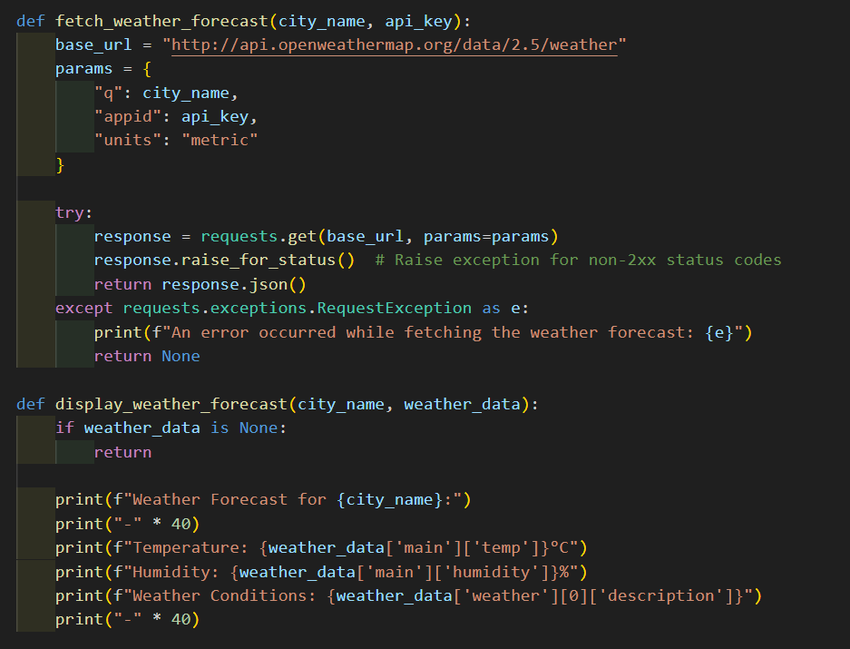
Code: Proposed Solution

Slide 20
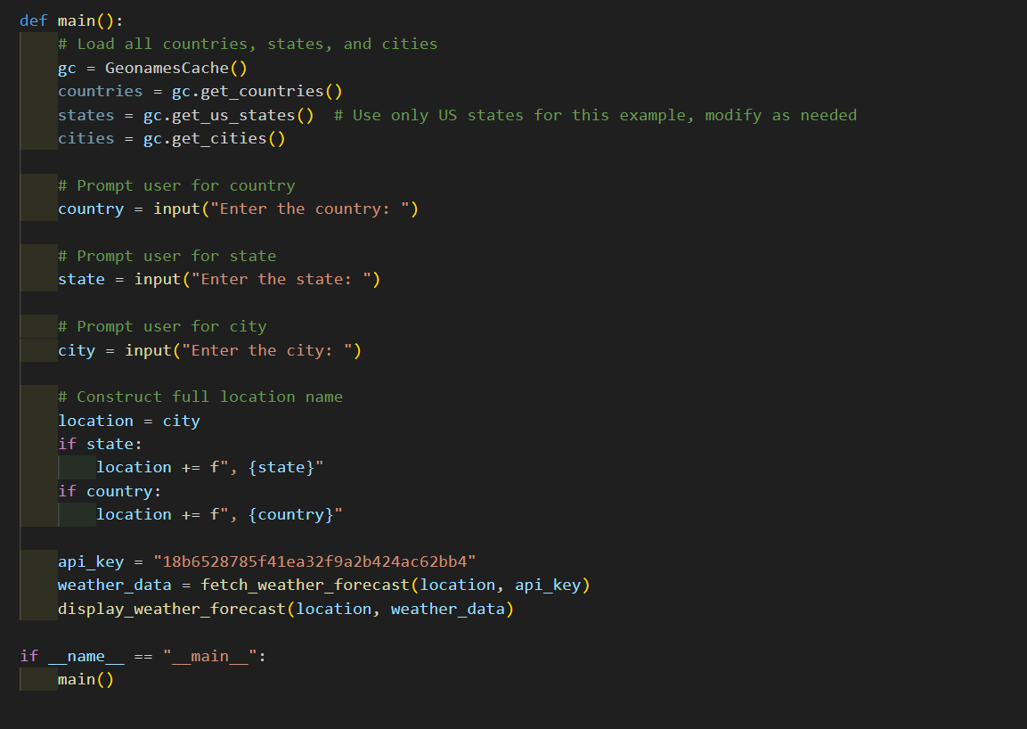
Code (Continued):

Slide 21
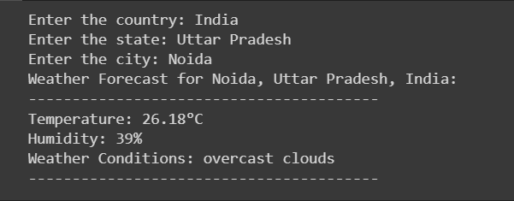
Output:

Slide 22
THANK YOU

